Slide 1
Integrative Approaches to Treating the Underlying Causes of Allergies
Corrie Marinaro, ND
New England Naturopathic Health

Slide 2
About me
Colby College class of 2000 alum
Liberal arts mind perfect match for Naturopathic Medicine
Opened NENH in September of 2012 as a solo practitioner…and look at us now!
Mainers Naturopathic Medicine!!!
Notes:
Healthy dose of libertarian distrust of big pharma

Slide 3

NENH Team

Slide 4
Naturopathic Medicine: Tolle Causum
Treating the cause versus suppressing the symptoms
[insert symptom here] is not a deficiency of [insert medication here]
Allergies are a great topic to demonstrate this model
In order to truly cure a symptom (ie, not just turn it off with a drug), underlying causes must be addressed

Slide 5
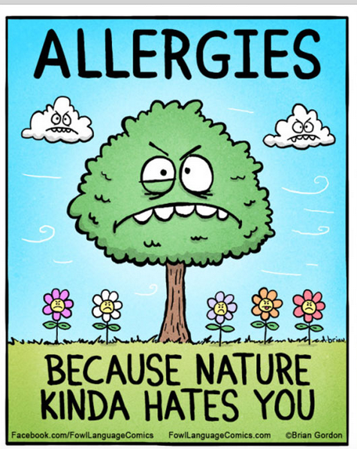

Slide 6
Allergy symptoms
Congestion/post-nasal drip
Itchy/watery eyes
Hives, eczema, other skin reactions…?
Asthma
Sleep apnea
Fatigue
Anxiety
.....all due to HISTAMINE

Slide 7
Conventional Treatment of Allergies
Diagnostics with skin prick test…what do we do with this information?
Daily meds: histamine blockers, steroids
Get rid of the animals (nooooooooo!)
Surgery?
Maybe some info on hypo-allergenic conditions in the household...
Underlying causes of histamine production never explored

Slide 8
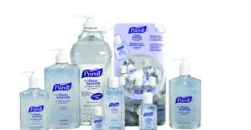
Underlying Cause of Allergies #1: The hygiene theory of immune tolerance

Slide 9
We are too clean!
Allergies are a first-world phenomena
First-world countries have an obsession with cleanliness
Sterilizing everything in our environment destroys the microbiome
Microbiome = collection of bacteria on our skin and mucosal surfaces
For every human cell in a human body there are 10,000 bacterial cells

Slide 10
Healthy Microbiome = immune tolerance
Immune tolerance = immune system’s ability to distinguish between something harmful vrs. non-harmful
When we lose immune tolerance, we begin to react to non-harmful substances in our environment as if they are threatening to us (which they aren’t)
Colds vrs allergies (this time of year)

Slide 11

Notes:
Before video games were invented

Slide 12
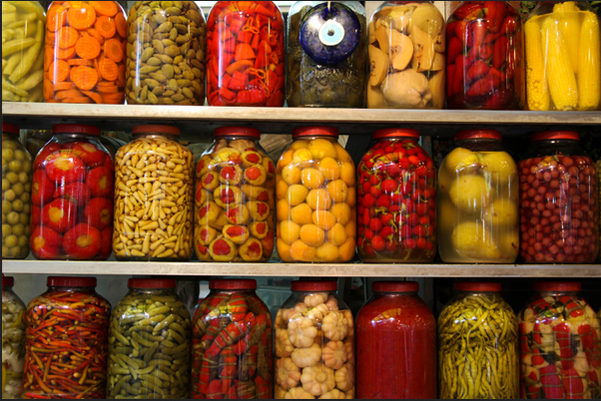

Slide 13

Underlying cause of allergies #2: Adrenal Fatigue

Slide 14
Factors affecting adrenal health
Working too much
Drinking too much caffeine
Poor nutrition
Over-training
Sleep deprivation (sleep apnea)
Emotional stress
Politics ☺
Delivering a baby/being a parent of a small child
Being a care-givers of a loved one

Slide 15
Precious Adrenal Glands
Give us energy to get through the day
Regulate our circadian rhythms or sleep-wake cycles with the rise and the fall of cortisol
Allow us to deal with emotional and physical stressors
Produce dopamine…the most enjoyable of the neurotransmitters
Provide the body with the anti-inflammatory properties of cortisol

Slide 16
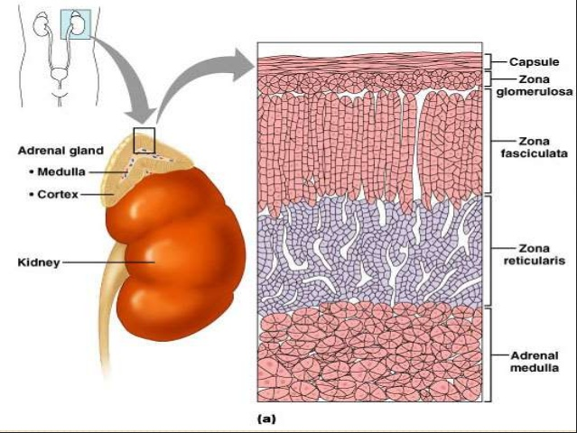

Slide 17
What happens when we ask too much of our adrenal glands?
We need more and more caffeine
We enjoy things less and less
Our sleep/wake cycles fall apart
Easily become hypoglycemic
Inflammation takes over as:
  Allergies/asthma
  Skin conditions
  Auto-immune conditions
  IBS
  Anxiety

Slide 18
We need to sloooooow down
Naps (gasp!)
Leisure time
Scheduling enough time for sleep
Scheduling a realistic amount of things in a day
Not hurrying
Less caffeine, slower pace of life
Foods that sustain the blood sugar

Slide 19
Underlying cause of allergies #3: food allergies
Think of food allergies if allergies occur year round
Most common cause of too much mucous is pasteurized, commercial cow’s milk dairy products
We are the only mammal that drinks the milk of another mammal
The calcium controversy

Slide 20


Slide 21
Other food allergies?
Food allergies are common especially if there are also GI symptoms (gas/bloating/loose stools, etc..)
Can be assessed through (gold standard) elimination diet or food allergy testing in the blood
Testing in blood searches for IgG antibodies to proteins associated with 96 different foods
If you are curious…find out! Food allergies can usually be cleared with avoidance and gut repair

Slide 22
Underlying cause of allergies #4: Home environment
Some common-sense pointers in handout
Mold is a huge trigger for many people, especially if genetically prone
Always rule out mold in your home and/or work environment if:
  There is a mildew smell
  Several people in the environment have severe allergies
  Allergies are worse in the winter when ventilation of buildings is poor

Slide 23
Testing and remediation
Homelabs
Mold test kits/services
Remediation should be done while sensitive person is not in the environment
Remediation often requires professional assistance
Dehumidifier in the basement and particulate air filters in living areas are always a good first step

Slide 24
Natural Methods of “Managing” Allergies
Histamine clearance co-factors
  B6, Magnesium, B5, B12, folate
  Vit C = histamine stablizer
  Probiotics….why?
  Vitamin D = immune modulator
Useful herbs for allergy Control
  Nettles, burdock, chickweed, chaga, tumeric, bromelain, quercitin
  Adrenal adaptogens like ginseng and rhodiola…why?

Slide 25
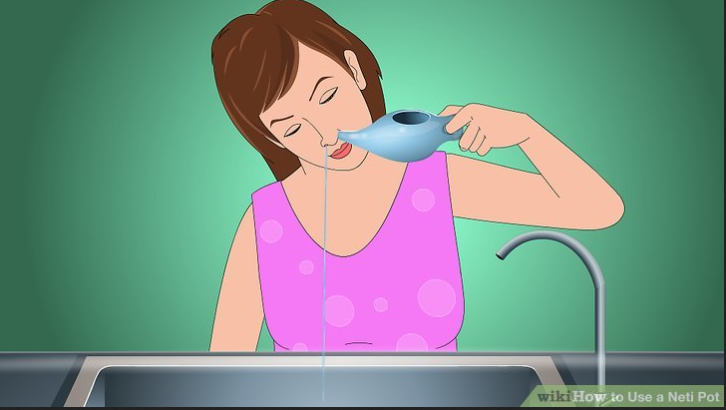
Neti pot…woo-hoo!

Slide 26
Nasal insufflation of ozone
Ozone therapy is used in the treatment of chronic infections and inflammation world-wide (just not so much in the US for obvious reasons)
Ozone can be administered to the sinuses to help get oxygen to the brain, balance allergenic immune reactions and clear any lurking bugs
Treatment should be at least once weekly, takes 10-15 minutes, cost-effective and provides lots of other great benefits

Slide 27
Take away messages
Allergies do not occur because you didn’t take enough Claritin
Allergies are multi-factorial and to reduce them, you have to take a look around your life and see what you can do to improve your gut function and stress levels (hint: usually related)
Reduce allergens in the environment, but don’t get rid of the dog!!
When all else fails, take out dairy, you’ll improve by at least 50% (this is especially true for kids)
Taking all of this into account, spring can be a happy time for allergy sufferers!

Slide 28
